Slide 1



Slide 2



 | Slope Bins 4 | Smear Count 25
Block number | Alpha w/ Henderson Hasselbalch | Chi Chi_max = 2.2
[0 50] | 0.040012 | 1.160000
[50 75] | -0.278451 | 0.720000
[75 125] | -0.519707 | 0.608000
[125 156] | -0.154453 | 0.529032

Slide 3


 | Slope Bins 4 | Smear Count 31
Block number | Alpha w/ Henderson Hasselbalch | Chi Chi_max = 2.2
[0 31] | 0.001103 | 0.922581
[31 62] | -0.386873 | 0.703226
[62 93] | -0.290146 | 0.967742
[93 496] | 0.037164 | 1.098759
[496 527] | -0.064533 | 0.819355
[527 620] | 0.010682 | 0.756989
[620 647] | -0.103326 | 0.696296

Slide 4
Approach
B, and v will be different for L and H
Chi should be same
Match pure L and H first, then mix
SCFT Purpose:
Additional information of underlying protein organization
Possible underlying conformational change driven by Cs

Slide 5
Summary

Slide 6









b2.0 v2.7 c3.2
b3.0 v3.5 c3.5
b3.0 v7.0 c3.5
b3.0 v7.0 c3.0
Phi too small
Phi too small to decrease v0
b4.0 v12.0 c3.0
b5.0 v20.0 c3.0
b5.0 v20.0 c4.0
b5.0 v5.0 c3.0
b5.0 v10.0 c3.0
Phi too small to decrease v0

Slide 7

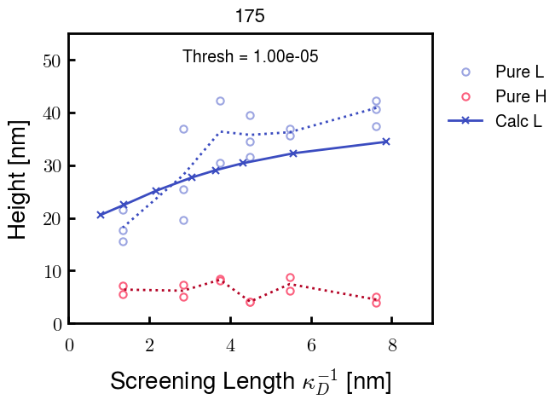
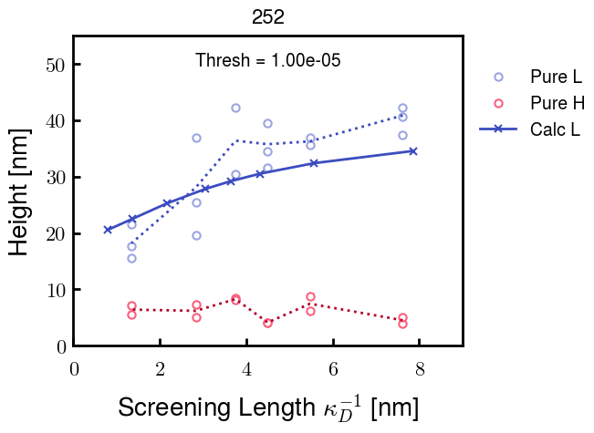



v2.7 and some fine
b1.50 v2.7 c3.2
b1.75 v2.7 c3.2
b1.75 v2.5 c3.2
b1.75 v2.5 c3.0
b2.0 v2.7 c3.2
b2.25 v2.7 c3.2
b2.50 v2.7 c3.2

Slide 8
v20 and some fine

Slide 9




b2.00 v2.70 c3.20
b2.00 v2.75 c3.20

Slide 10
NFH fitting (from NFL best fit)

Slide 11








b1.00, v0.50, c3.2
b2.00, v4.00, c3.2, th2.5e-02
b1.00, v2.00, c3.2
b1.00, v1.00, c3.2

Slide 12
Mixture

Slide 13



Slide 14


b = 0.75

Slide 15





Slide 16
b = 1.0

Slide 17





Slide 18
b = 1.25

Slide 19




Chi 2.6
Bad vol frac

Slide 20








b25v0
b25v1
b25v2
b25v3

Slide 21




Chi 2.8
Bad vol frac

Slide 22





Slide 23
b = 1.50

Slide 24






Chi 2.8
Bad vol frac

Slide 25





Slide 26

b = 2.00
v4 = 0.25*b^3

Slide 27


Bad vol frac

Slide 28



Slide 29
Fine tune

Slide 30



b1.25, v1.95, c3.0
b1.50, v3.38, c3.0
b2.00, v4.00, c3.0
Norm seems to capture kinked behavior

Slide 31




Slide 32



b1.25, v1.95, c3.2
b1.50, v3.38, c3.2
b2.00, v4.00, c3.2

Slide 33




Slide 34


b1.25
b1.50
b2.00
c2.8
c3.0
c3.2

